Slide 1
M.A.C. REFLECTION
Kevin, Ryan, Steve

Slide 2
OVERVIEW
Project Overview
User Experience
Design Evolution
Project Reflection

Slide 3
Project Overview
Problem
We need easier communication between employees
Solution
The HAL Interconnection Network(THIN)
Social Media Messaging Application
Intended Audience
Employees of HAL Corporation

Slide 4
T.H.I.N.
What is it?
A company-wide social network
How does it work?
Post
Follow users
Follow hashtags
See the posts they want to see

Slide 5
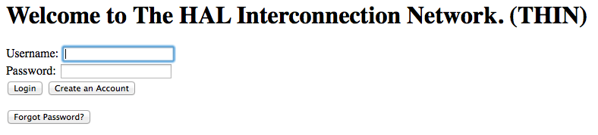
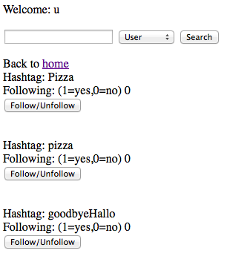
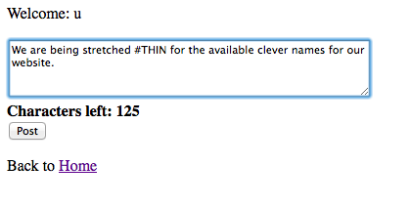
Seeing Some of the Implementation
Sign In
Displaying Hashtags in system
Post

Slide 6
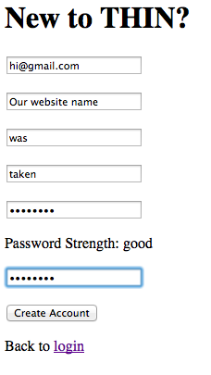
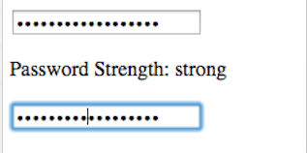
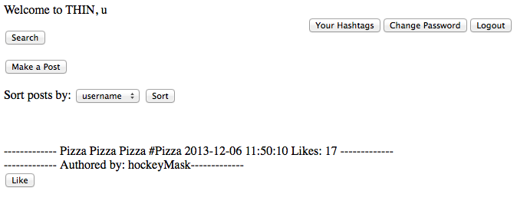
Seeing Some of the Implementation
Signing up
Password strength
Main page

Slide 7
Design Evolution
No web development experience
Languages
Intended to use php, mysql, javascript
Minimal javascript
MVC architecture
Getters/Setters in model
Sorting redirecting in controller
Php pages in views

Slide 8
Missing Features
UI design
Missing CSS
Requirements 2 and 14 were dropped from the required list of functionalities
Still Implementing:
Requirement 13- finish sorting Posts

Slide 9
Project Reflection Overview
What did we learn?
How could we have improved the project?
What is one thing we would change?
Key Technologies

Slide 10
What did we learn?
Crash course in web development
Teammate Problems
1 member was dropped
Division of Labor
Internal vs. External Deadlines

Slide 11
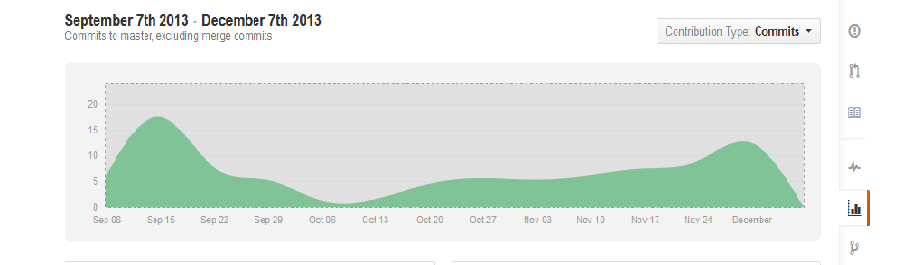
Commits
November 08 2013 - December 08 2013:
3 authors have pushed 55 commits to all branches, excluding merges. On master, 26 files have changed and there have been 3,809 additions and 0 deletions.

Slide 12
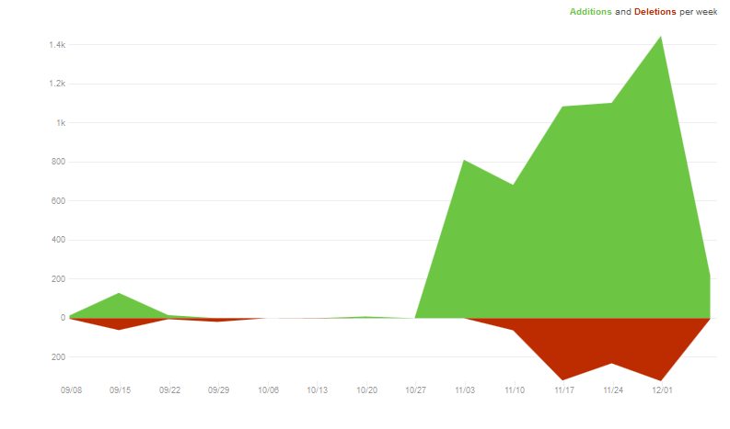
Code Frequency

Slide 13
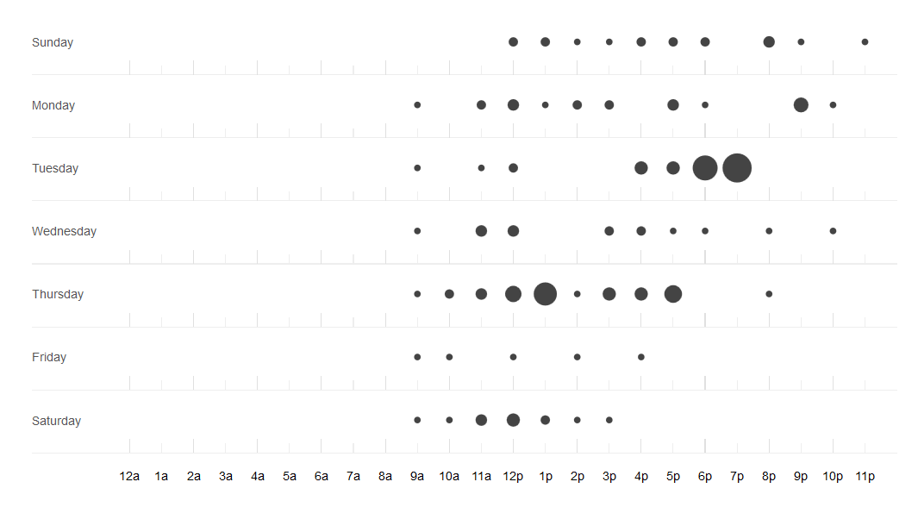
Punchcard

Slide 14
How could we have improved?
Meeting more frequently
Get more experience with web development
Have a full group
What is one thing we would change?
Focus on UI

Slide 15
Key Technology
Xampp- free apache webserver integrated with php and mysql
MySQLi-
GIT-dealing with merge conflicts

Slide 16

Questions

